Slide 1
















University Event Tickets Booking System
BY:
Sahab Al-Amri
Rahaf Faisal Saif Al-Rawas
Bayan Al-Mardoof

Slide 2









Project Objectives
physical Design
Requirement Specification
Queries
Conceptual Design
Insights
Logical Design

Slide 3





Requirement Specification
A university wants to manage data about users, events, tickets, payments, and organizers.
Each user has a unique user ID, full name, email, phone number, date of birth, gender, and registration date.
Each event has an event ID, event name, event date, location, price, category, total seats, and available seats.
A user can book multiple tickets, and each event can have many tickets.
Each ticket links a user to a specific event and includes a seat number, booking date, quantity, and booking status (Confirmed / Cancelled / Pending).
Each payment has a unique payment ID, amount, payment method, payment date, and status (Completed / Pending). Every ticket may have one payment record, and each payment belongs to only one ticket
Each organizer has a unique organizer ID, name, phone number, and email, One organizer can manage multiple events.
Entity Relationships
Users and Tickets → Users can book many tickets (one-to-many)
Tickets and Events → Each ticket links a user to a specific event. and each event can have many tickets (One-to-Many)
Tickets and Payments → Each ticket may have one payment record, and each payment belongs to only one ticket(One-to-One).
Organizers and Events → One organizer can manage multiple events (One-to-Many).

Slide 4


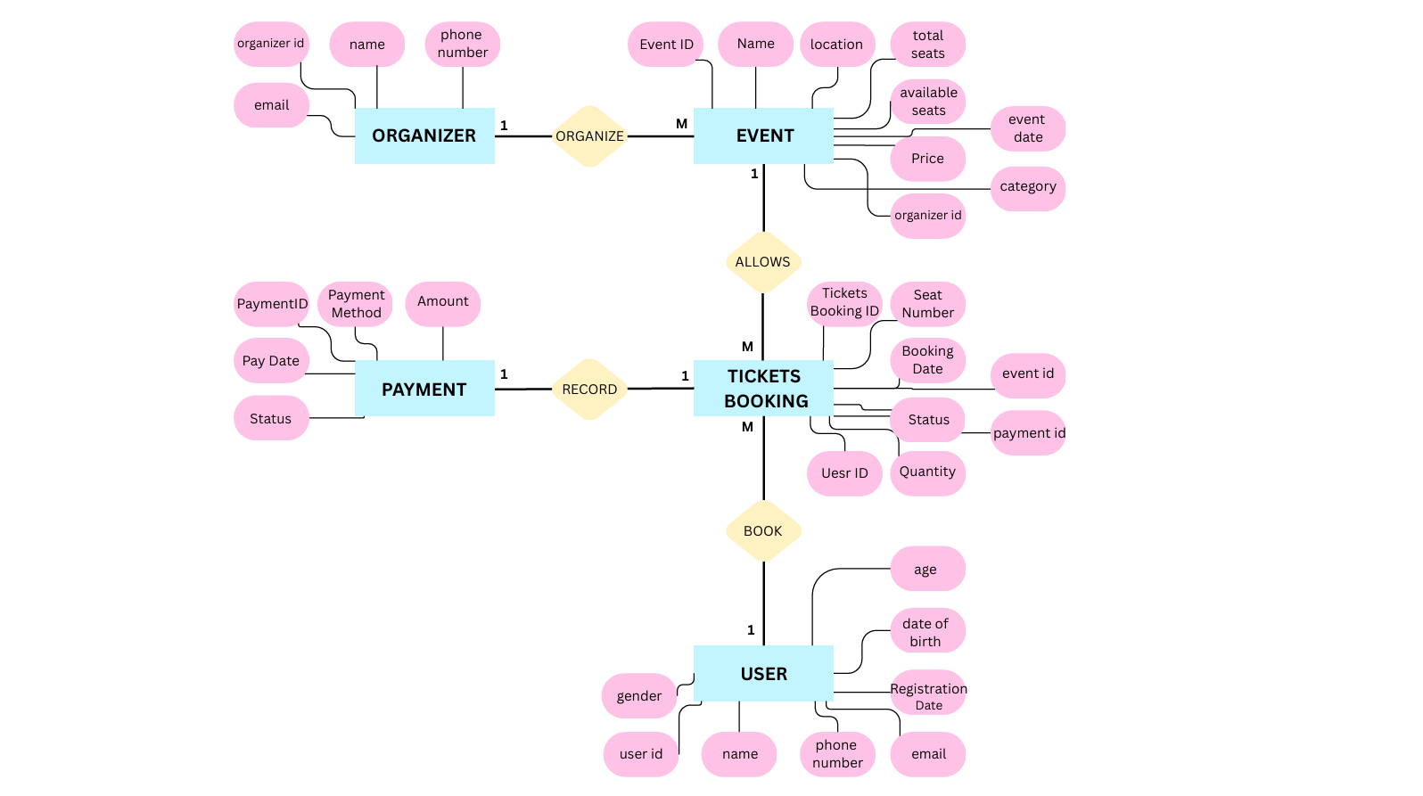

Conceptual Design

Slide 5
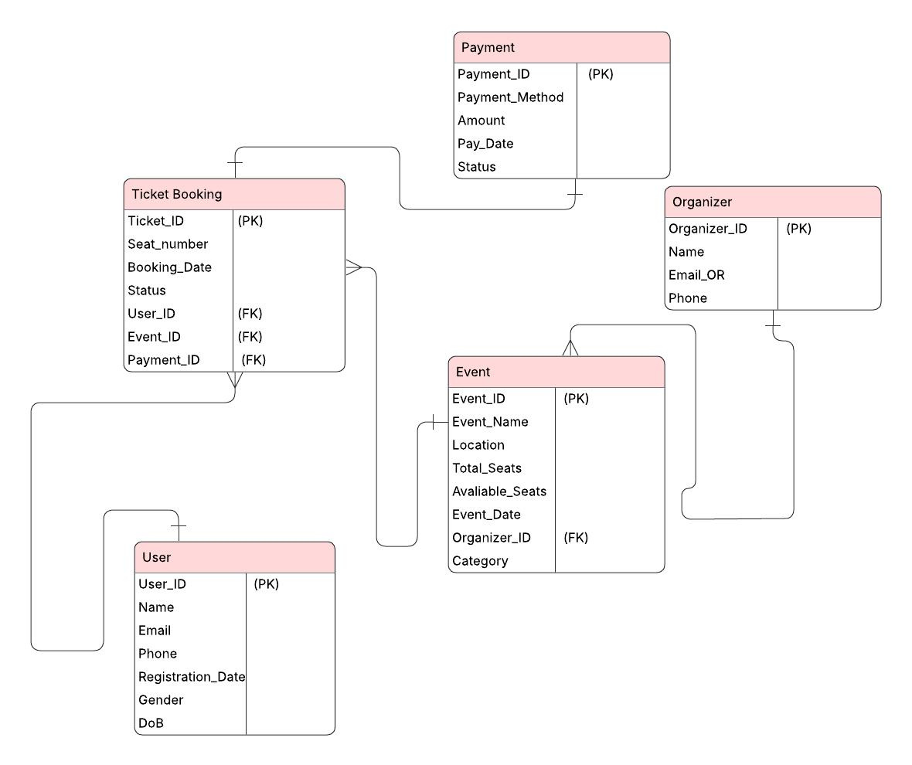

Logical Design

Slide 6

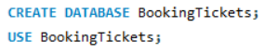
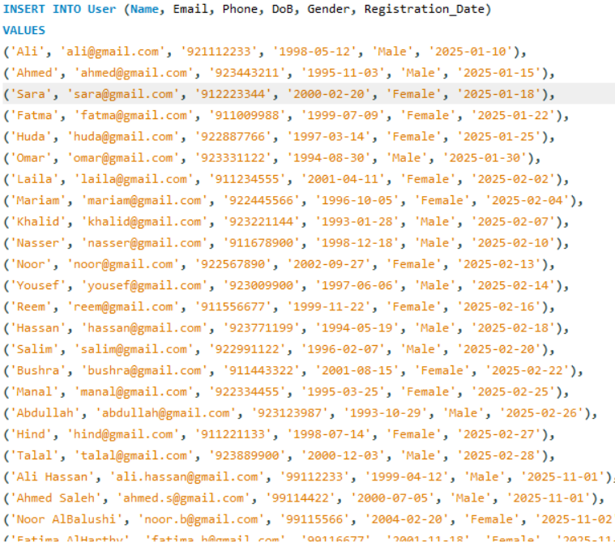
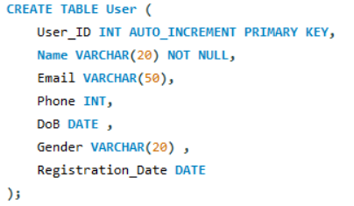
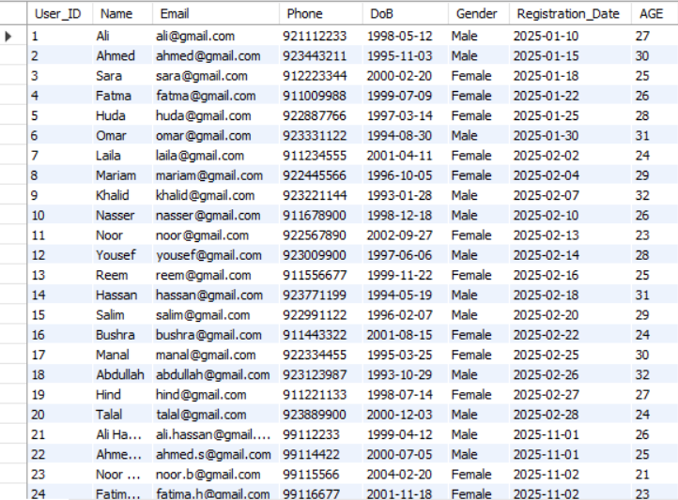
Creating a database specific to the ticketing system.
INSERT DATA INTO User TABLE
The User table stores the data of each user who makes a booking.

Slide 7
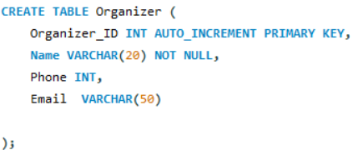
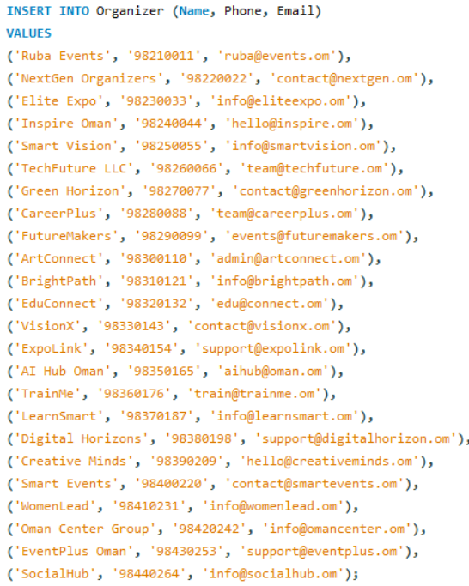
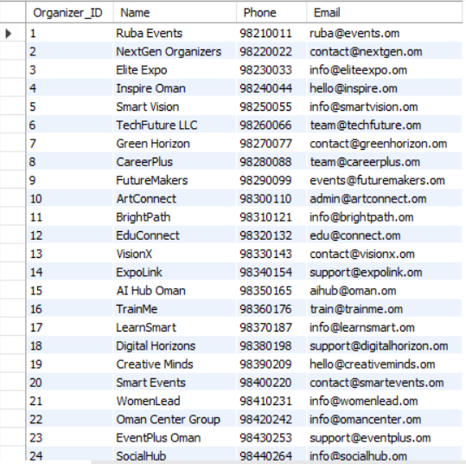
This table represents the companies or organizations that organize events.
INSERT DATA INTO TABLE Organizer

Slide 8
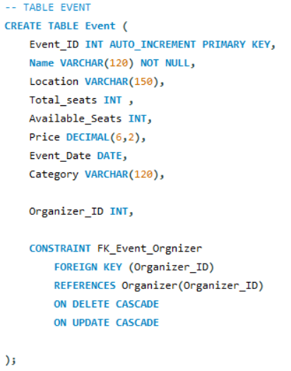
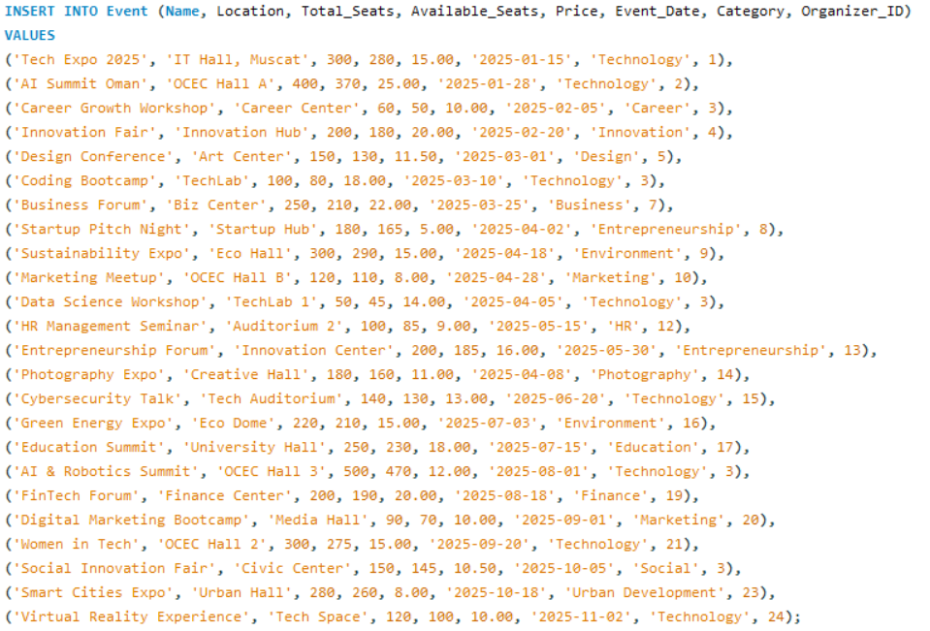
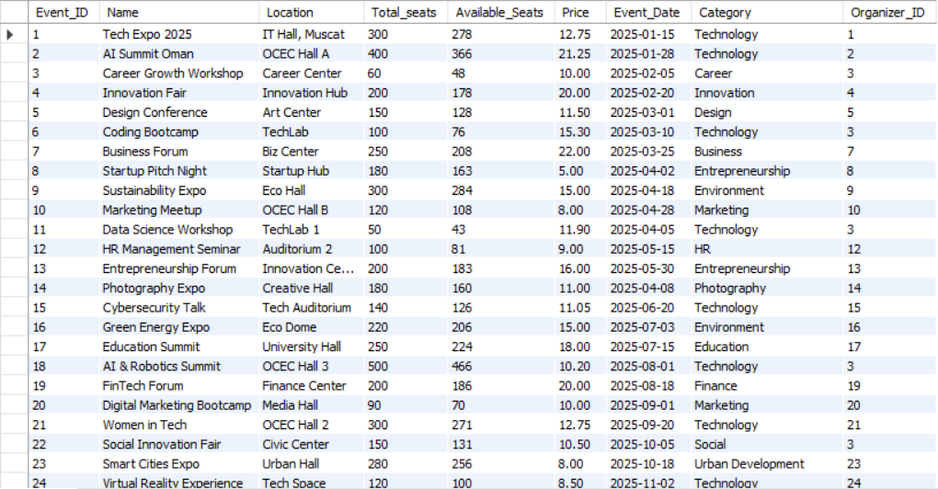
This table represents the events.
INSERT DATA INTO TABLE Event

Slide 9
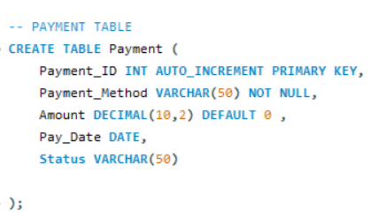
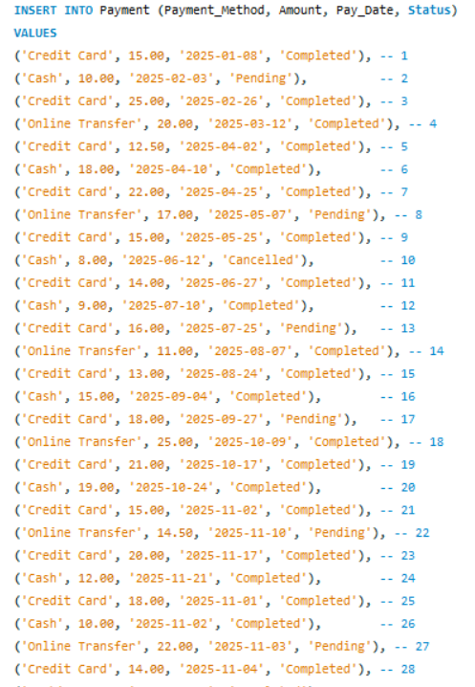
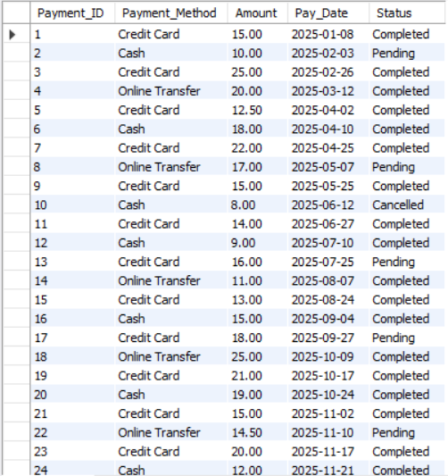
This table records every payment transaction made by a user.
INSERTING VALUES INTO PAYMENT TABLE

Slide 10
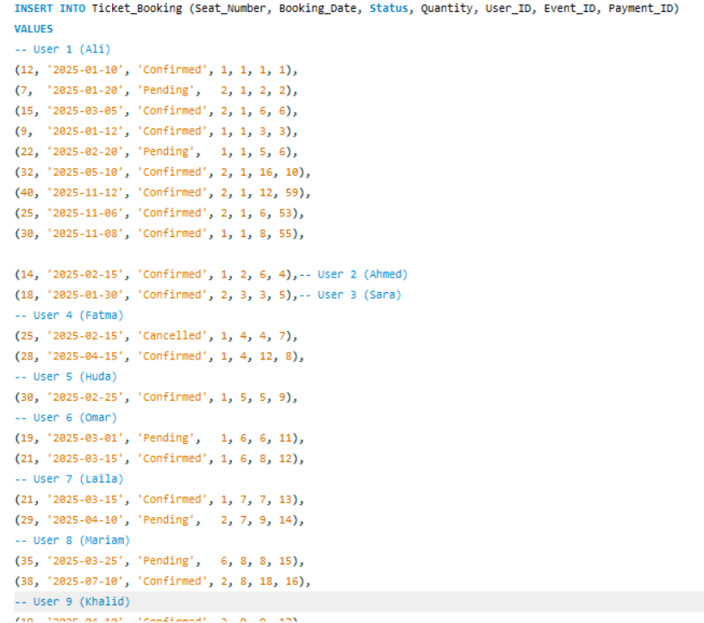
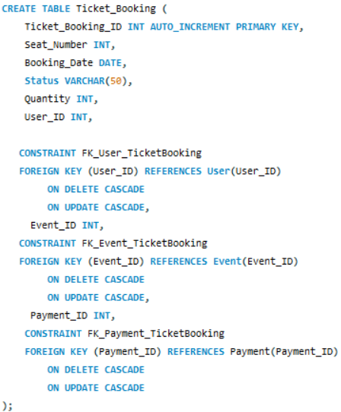
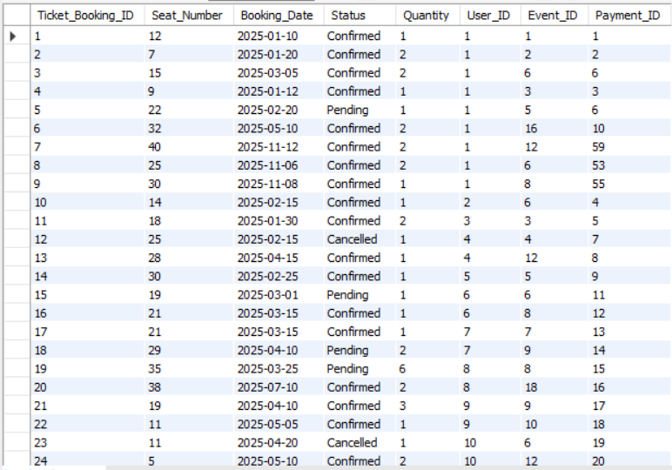
Ticket_Booking TABLE
This table links user + Event+ payment
INSERT DATA INTO TABLE Ticket_Booking

Slide 11
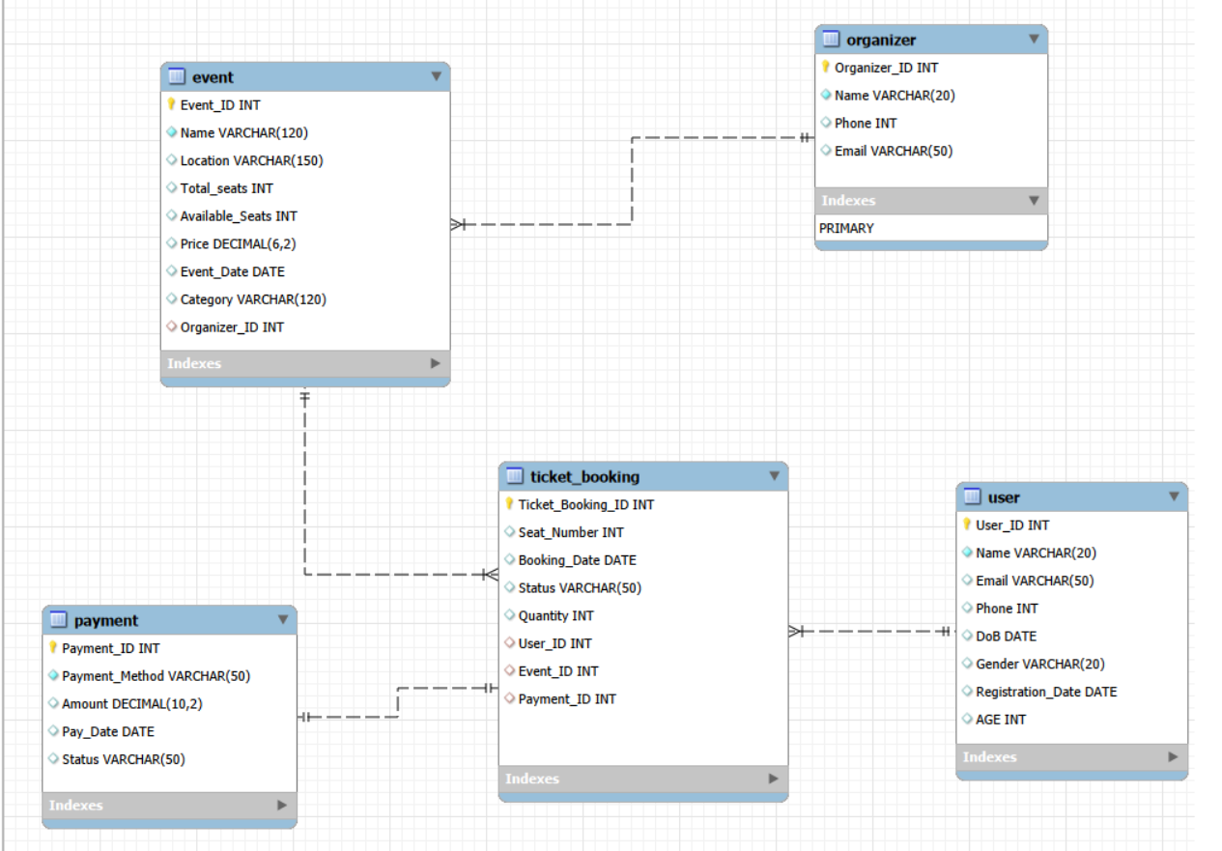
Physical Design

Slide 12
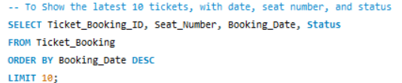
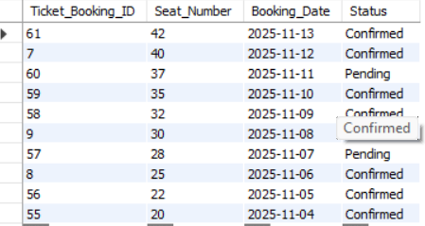
SQL Query
Displays the most recent 10 ticket bookings by ordering them from newest to oldest.

Slide 13
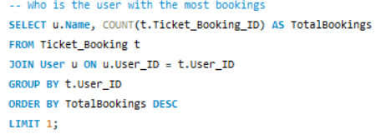
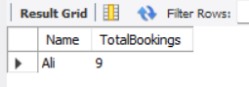
SQL Query
Counts how many bookings each user has made and returns the top user.

Slide 14
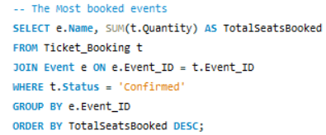
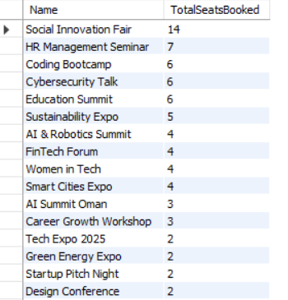
SQL Query
Sums the quantity of confirmed bookings to find the most attended event.

Slide 15
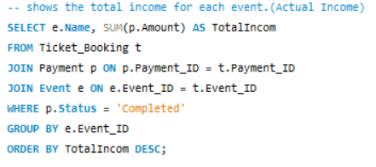
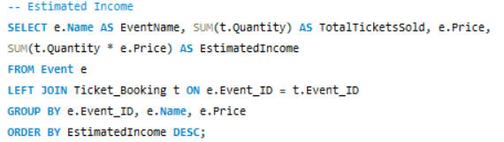
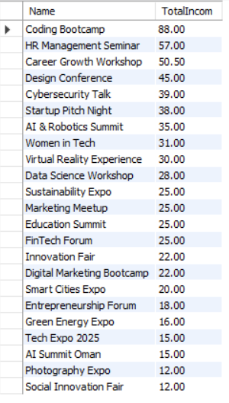
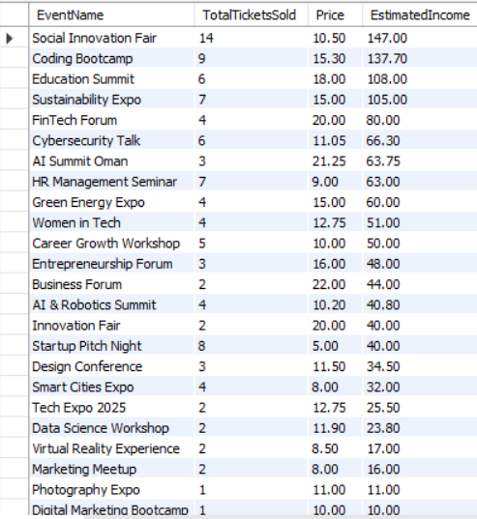
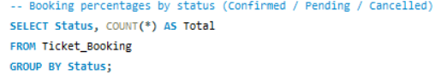
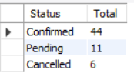
SQL Query
Sums only completed payments to calculate real income.
Shows potential income assuming all booked tickets were paid.
Helps understand distribution of booking outcomes.

Slide 16
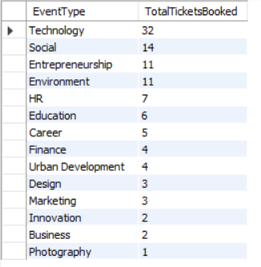
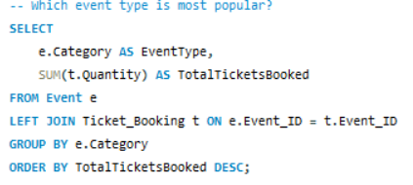
SQL Query
Shows which event type attracts the biggest audience.

Slide 17
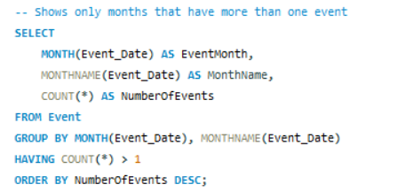
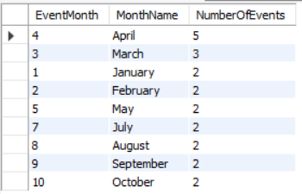
SQL Query
Months with More Than One Event

Slide 18
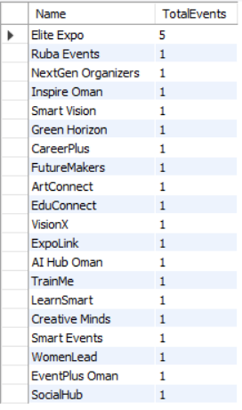
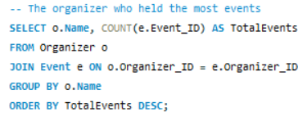
SQL Query
Shows which organizer is the most active.

Slide 19
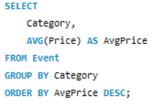
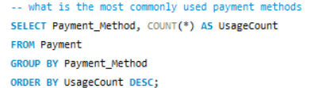
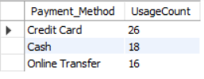
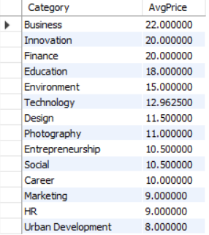
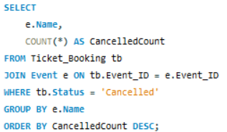
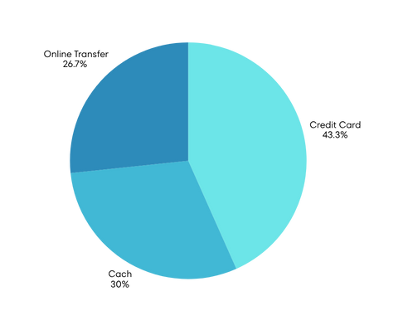
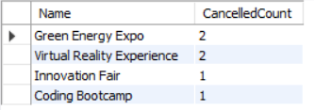
SQL Query
Average Ticket Price per Category
Most Used Payment Method
Event with Highest Cancelled Bookings

Slide 20
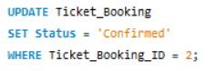
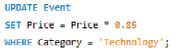
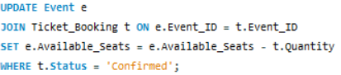
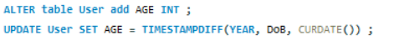
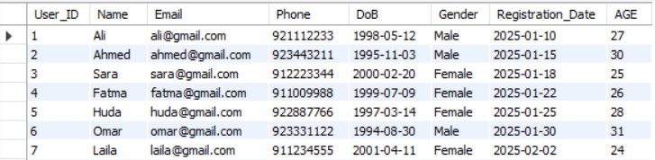
SQL Query
Change ticket status from Pending to Confirmed
Apply a 15% discount to all events in the Technology category
Deducts purchased seats from the available seats of each event
Add new column to automatically computes user age using TIMESTAMPDIFF

Slide 21
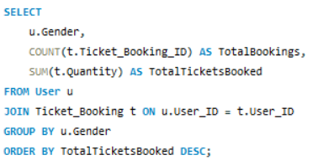


SQL Query
the users that is more active or interested in events based on gender.

Slide 22


SQL Query
Tickets Sold by Price Range : Classify events into three price categories

Slide 23

Insights
Most Active Users: Users with highest bookings show strong engagement.
Popular Events & Categories: High ticket bookings highlight audience preferences.
Income Analysis: Estimated vs. actual income shows revenue gaps.
Booking Status Distribution: Confirms patterns in Confirmed / Pending / Cancelled.
Seasonal Trends: Certain months have more events.
Top Organizers: Organizers hosting most events demonstrate strong performance.
Payment Preferences: Most used methods optimize checkout experience.
Gender Engagement: Shows which gender is more active.
Cancelled Bookings: Highlights events needing attention.
Pricing Insights: Average ticket price varies by category.

Slide 24


